Slide 1
Probability
Mathematics Holiday Homework
Vinayak Singh
Class XI A

Slide 2
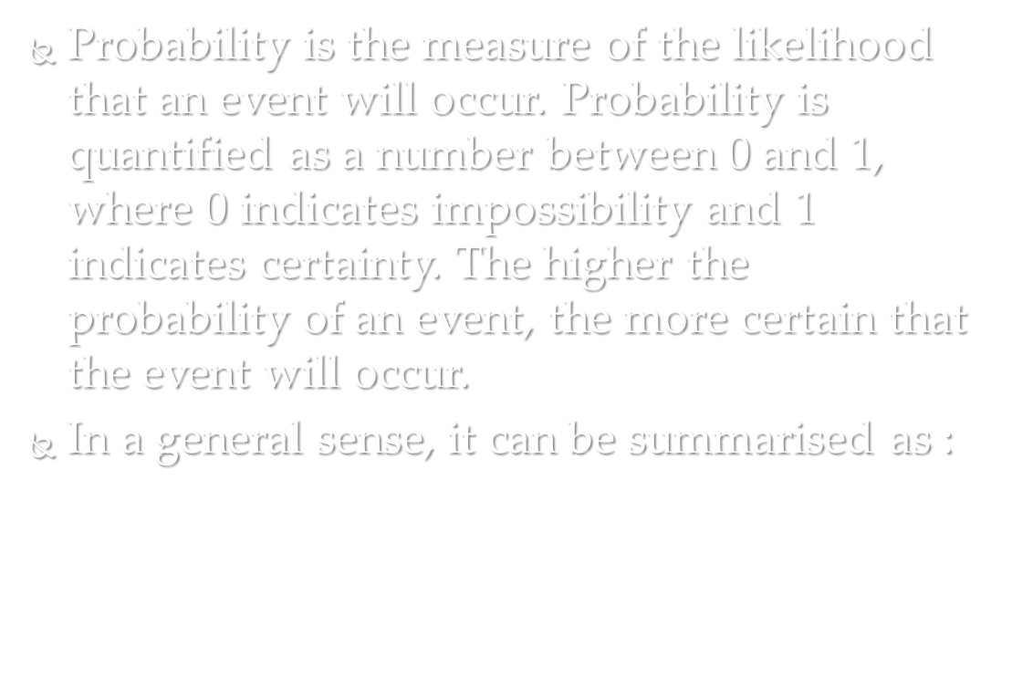
Introduction
Probability is the measure of the likelihood that an event will occur. Probability is quantified as a number between 0 and 1, where 0 indicates impossibility and 1 indicates certainty. The higher the probability of an event, the more certain that the event will occur.
In a general sense, it can be summarised as :
Probability of event = $\frac{Number of favourable outcomes}{Total number of outcomes}$

Slide 3
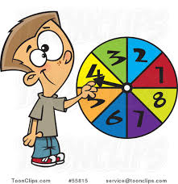
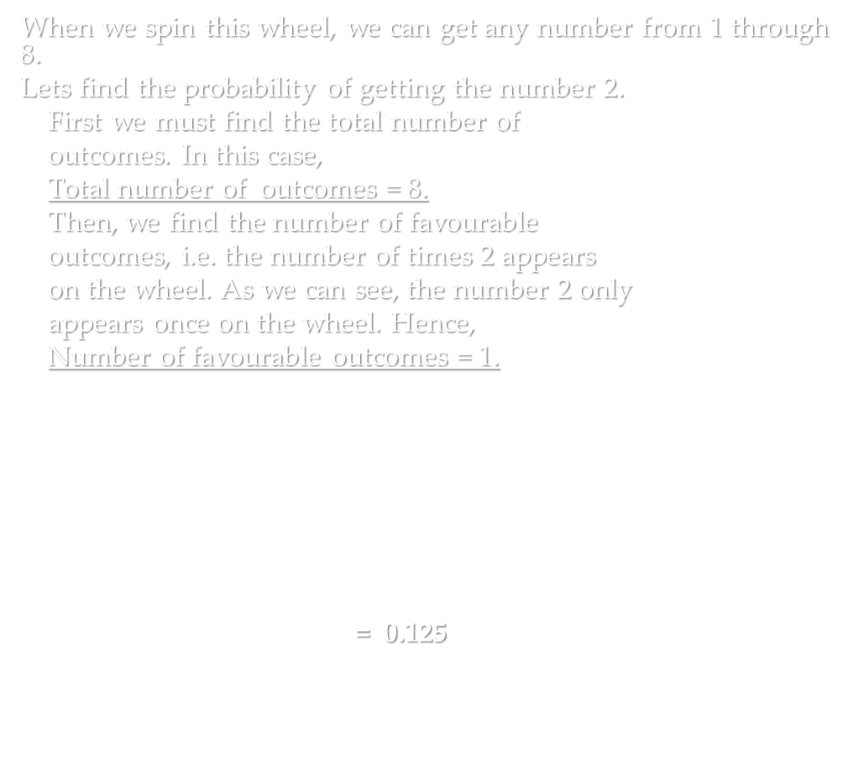
For example :
When we spin this wheel, we can get any number from 1 through 8.
Lets find the probability of getting the number 2.
First we must find the total number of
outcomes. In this case,
Total number of outcomes = 8.
Then, we find the number of favourable
outcomes, i.e. the number of times 2 appears
on the wheel. As we can see, the number 2 only
appears once on the wheel. Hence,
Number of favourable outcomes = 1.
Now we will divide the total number of outcomes
by the number of favourable outcomes.
Probability of event = $\frac{Number of favourable outcomes}{Total number of outcomes}$
Hence, P(getting a 2) = $\frac{1}{8}$
= 0.125

Slide 4
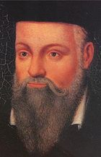
History
The scientific study of probability is a modern development of mathematics. Gambling shows that there has been an interest in quantifying the ideas of probability for millennia, but exact mathematical descriptions arose much later.
The sixteenth century Italian polymath Gerolamo Cardano, pictured here, demonstrated the benefit of defining odds as the ratio of favourable to unfavourable outcomes (which implies that the probability of an event is given by the ratio of favourable outcomes to the total number of possible outcomes). His work is considered to be a landmark in the scientific study of probability.

Slide 5
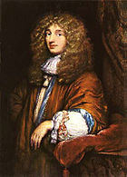
Christiaan Huygens probably published the first book on probability. He pioneered work on games of chances.
Another pioneer in Set Theory, and thus by extension in probability, was Augustus De Morgan. He formulated De Morgan’s laws which are used in probability.

Slide 6
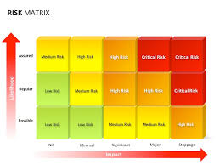
Applications
Probability theory is applied in everyday life in risk assessment and modelling.
The insurance industry and markets use actuarial science to determine pricing and make trading decisions.
Governments apply probabilistic methods in environmental regulation, entitlement analysis (Reliability theory of aging and longevity), and financial regulation.

Slide 7
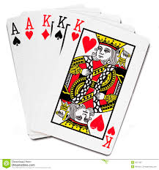
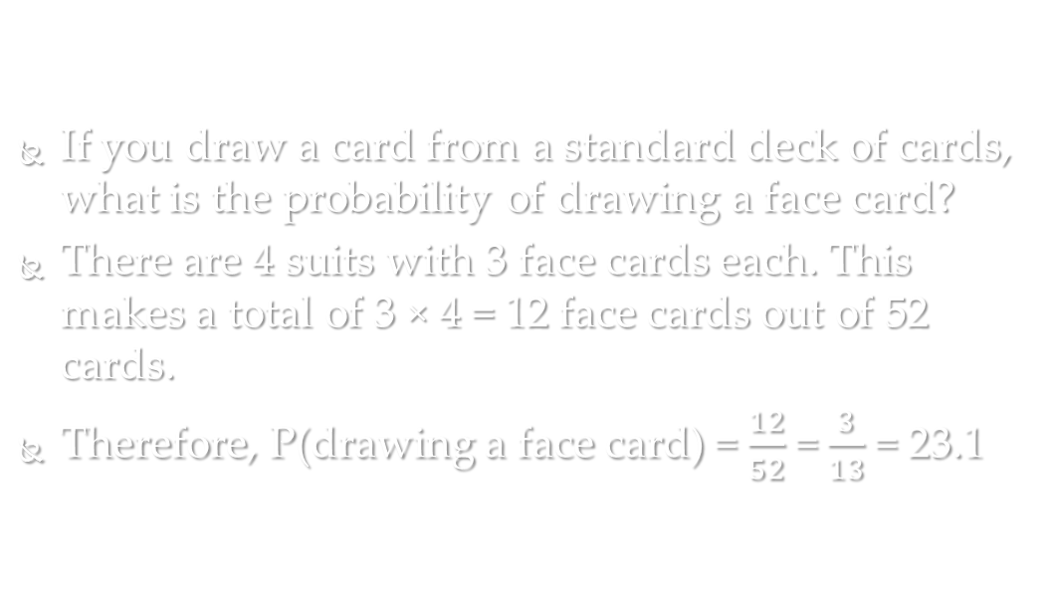
Examples
1. If you draw a card from a standard deck of cards, what is the probability of drawing a face card?
If you draw a card from a standard deck of cards, what is the probability of drawing a face card?
There are 4 suits with 3 face cards each. This makes a total of 3 × 4 = 12 face cards out of 52 cards.
Therefore, P(drawing a face card) = $\frac{12}{52}$ = $\frac{3}{13}$ = 23.1

Slide 8
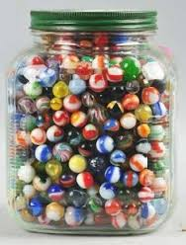
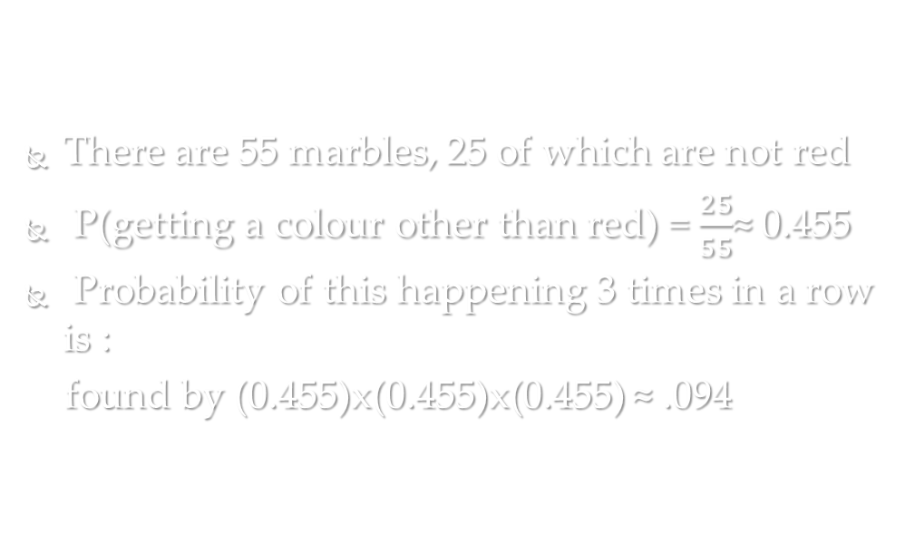
2. A jar contains 30 red marbles, 12 yellow marbles, 8 green marbles and 5 blue marbles. What is the probability that you draw and replace marbles 3 times and you get NO red marbles?
There are 55 marbles, 25 of which are not red
P(getting a colour other than red) = $\frac{25}{55}$≈ 0.455
Probability of this happening 3 times in a row is :
found by (0.455)x(0.455)x(0.455) ≈ .094

Slide 9
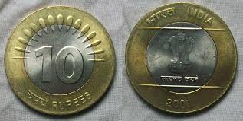
Activity to better understand Probability
Let us toss a coin.
When we toss a coin there are two possible outcomes. There's a chance that the coin could land on Heads, and there's a chance that the coin could land on Tails.
I tossed a coin 30 times and recorded the outcomes in the table on the following page.

Slide 10
S no. | Outcome | S no. | Outcome
1 | Tails | 16 | Heads
2 | Tails | 17 | Tails
3 | Heads | 18 | Heads
4 | Tails | 19 | Heads
5 | Heads | 20 | Tails
6 | Heads | 21 | Heads
7 | Tails | 22 | Tails
8 | Tails | 23 | Tails
9 | Heads | 24 | Tails
10 | Heads | 25 | Tails
11 | Tails | 26 | Tails
12 | Heads | 27 | Heads
13 | Heads | 28 | Heads
14 | Heads | 29 | Tails
15 | Tails | 30 | Tails
After this activity, we can see that out of 30 times, Tails was the outcome 16 times, and Heads occurred 14 times.
This shows that we are getting a tail roughly half the times, and vice versa.
If we use the formula, probability of getting a 2 is 0.5.
Thus we see that using probability, we can very realistically ‘predict’ the outcome of certain events.

Slide 11
Permutation and Combination : Essential processes in Probability
Permutation : permutation relates to the act of arranging all the members of a set into some sequence or order, or if the set is already ordered, rearranging (reordering) its elements, a process called permuting.
Simply speaking, Permutations are the different ways in which a collection of items can be arranged.

Slide 12

FOR EXAMPLE
The different ways in which the alphabets A, B and C can be grouped together, taken all at a time, are ABC, ACB, BCA, CBA, CAB, BAC.
Note that ABC and CBA are not same as the order of arrangement is different. The same rule applies while solving any problem in Permutations.

Slide 13

FOR EXAMPLE :
Find the probability of forming a word from the letters of the word ‘SUPER’ such that the vowels always come together?
The word ‘SUPER’ contains 5 letters.
In order to find the number of permutations that can be formed where the two vowels U and E come together.
In these cases, we group the letters that should come together and consider that group as one letter.
So, the letters are S,P,R, (UE). Now the number of words are 4.
Therefore, the number of ways in which 4 letters can be arranged is 4!
In U and E, the number of ways in which U and E can be arranged is 2!
Hence, the total number of ways in which the letters of the ‘SUPER’ can be arranged such that vowels are always together are 4! * 2! = 48 ways.
Now, the total number of words that can be formed are :
5! = 5x4x3x2x1 = 120.
Hence, the probability is 0.4.

Slide 14
Combination is a way of selecting items from a collection, such that (unlike permutations) the order of selection does not matter. In smaller cases it is possible to count the number of combinations.
It is simply a manner of selection of members from a given group. In such kind of selection the order does not make a difference.

Slide 15


FOR EXAMPLE
Let us suppose we have 12 adults and 10 kids as an audience of a certain show. Find the probability the host can select three persons from the audiences to volunteer. The choice must contain two kids and one adult.
Solution: As order here does not matter so we have:
C (10, 2) * C (12, 1) = [10 * 9292] * [121121] = 45 * 12 = 540.
So there are 540 ways in which the host can choose the volunteers containing two kids and an adult.
Now, let us find the total number of ways in which the host can select three persons, which is C(22,3) = $\frac{22!}{\left(3!\right)\left(22−3\right)!}$ =1540.
Hence the probability is 0.3506.

Slide 16
THANK YOU

